Slide 1



pp_Chat GUI Project
Summer Xiao
Scott Ye

Slide 2
Introduction

Slide 3
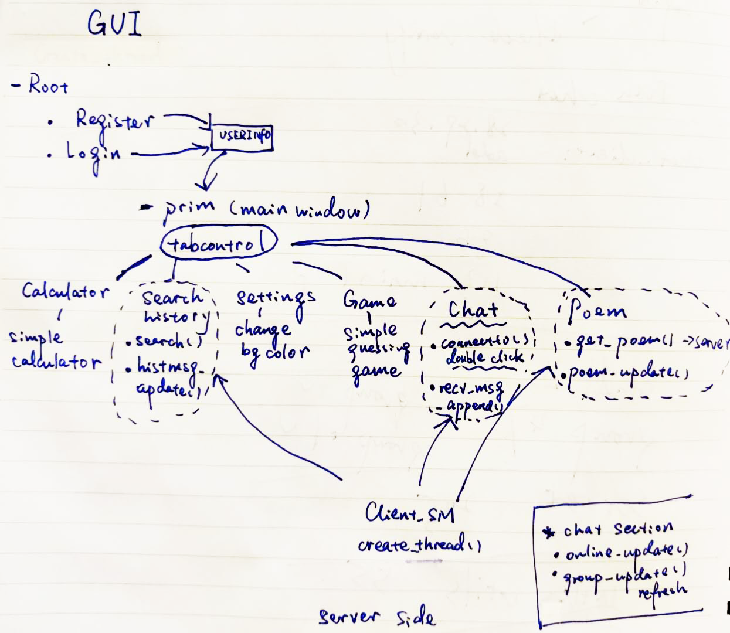
Structure of Our app

Slide 4
Our Approach
Sketch the GUI Interface
Complete the tabs, frames, textboxes for later connection
Complete the local functions (Calculator, game, settings)
Connect the GUI to the server
Debug and improve

Slide 5
GUI Code

Slide 6
Improvements on the Server Side

Slide 7
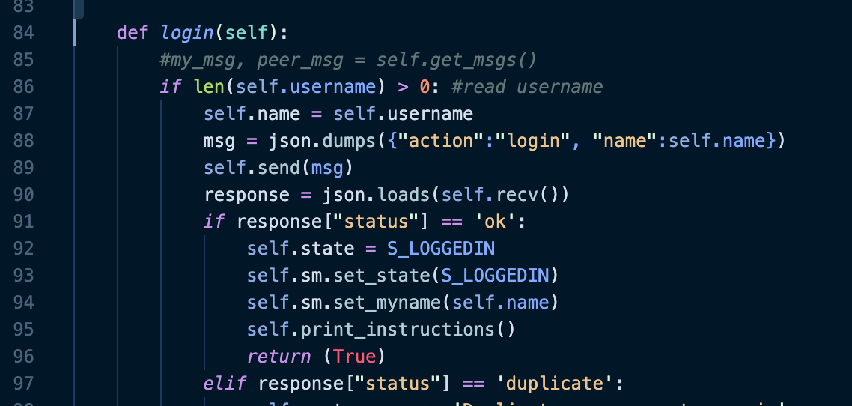
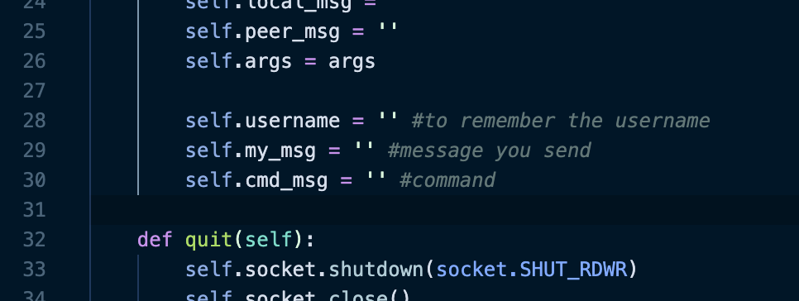
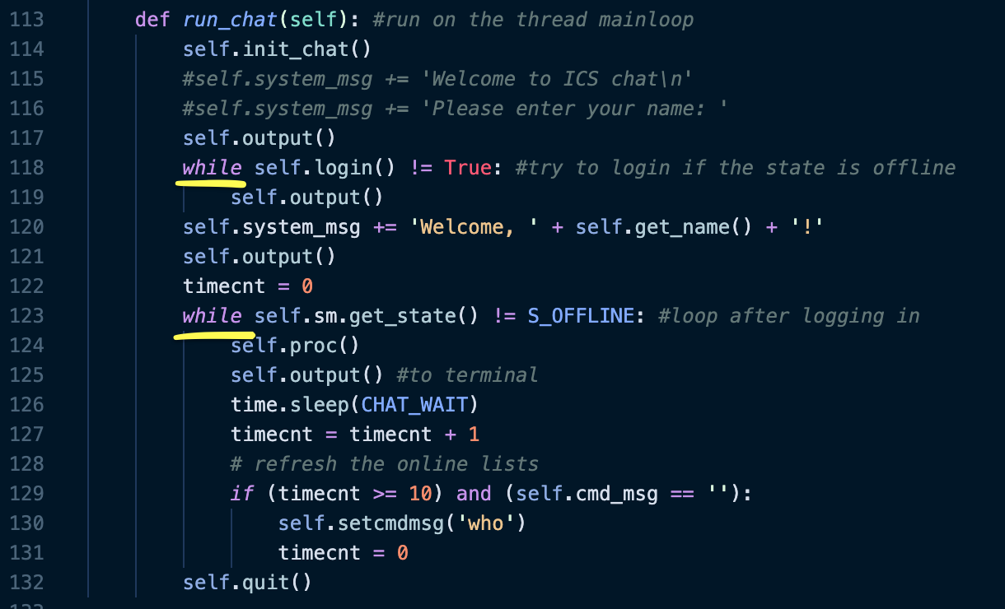
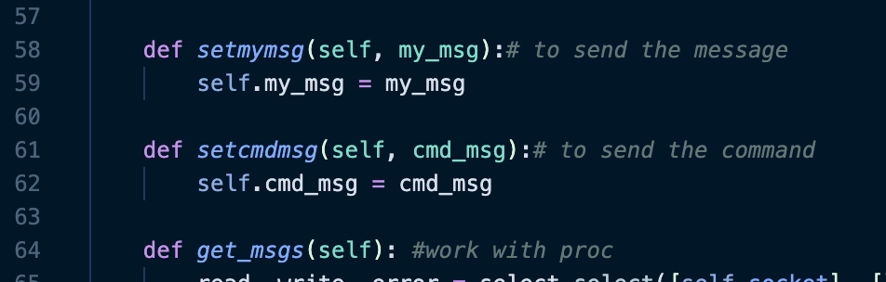
chat_client.py
Make sure the username exists
Separate messages and commands
Mainloop

Slide 8
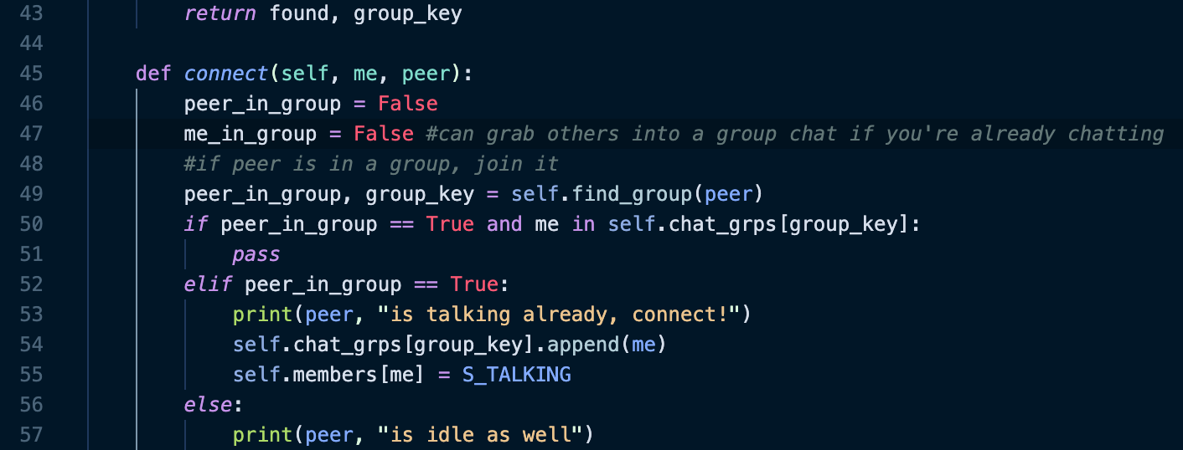

chat_group.py

Slide 9
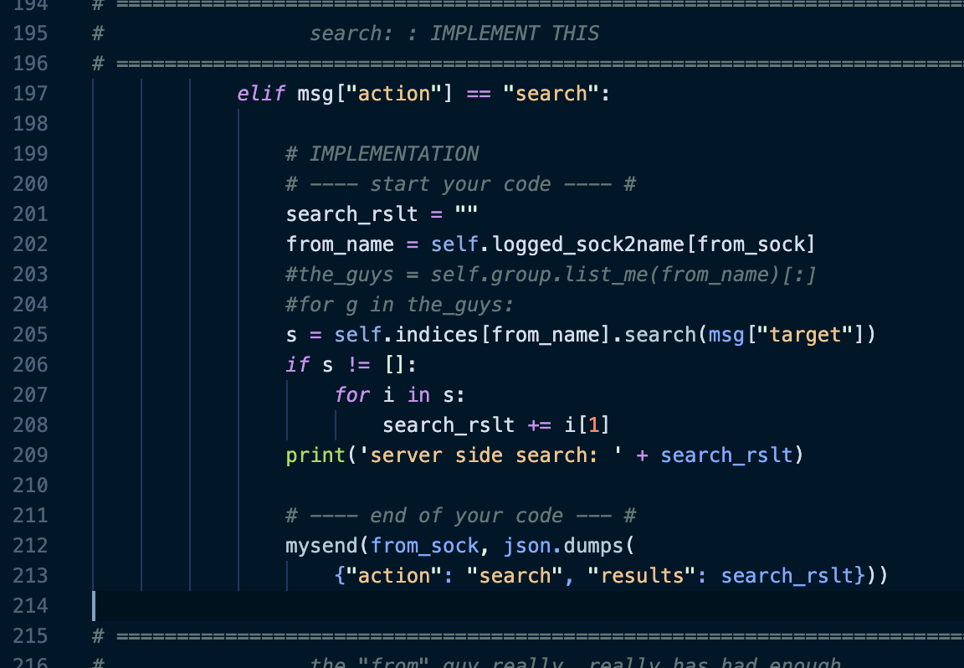
chat_server.py
Problem occurs when using search function during chatting

Slide 10
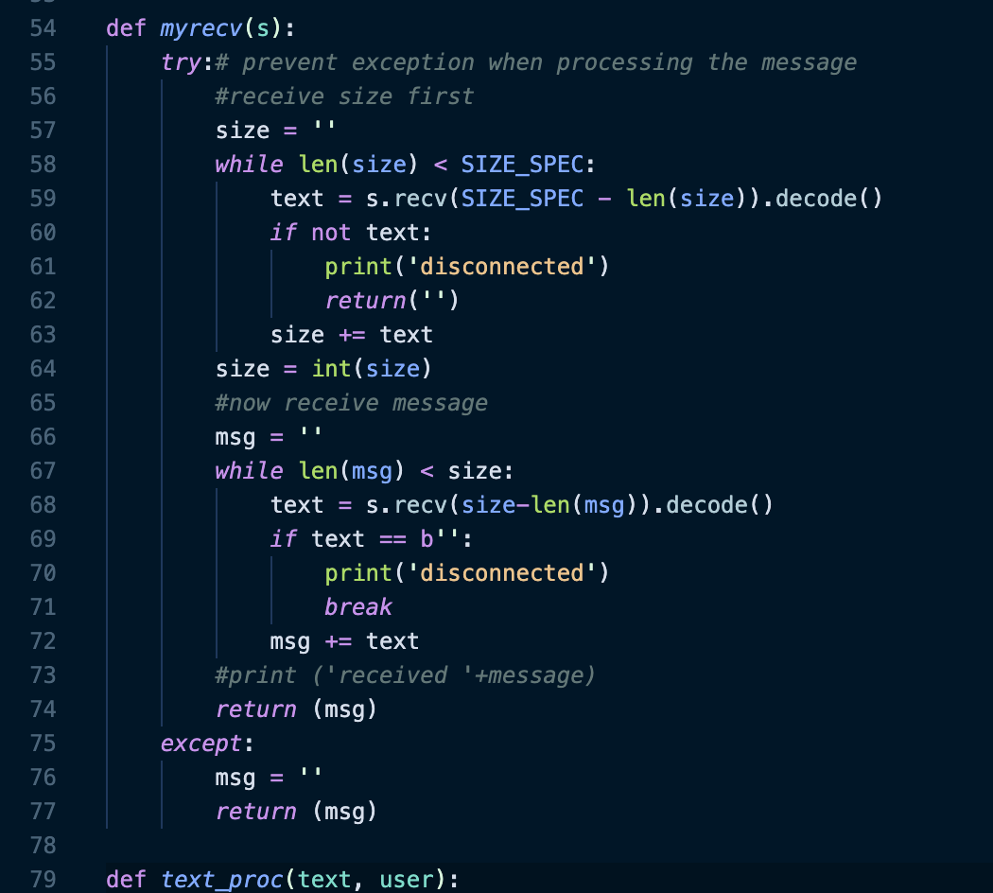
chat_utils.py
Prevent crashing when an exception occurs

Slide 11
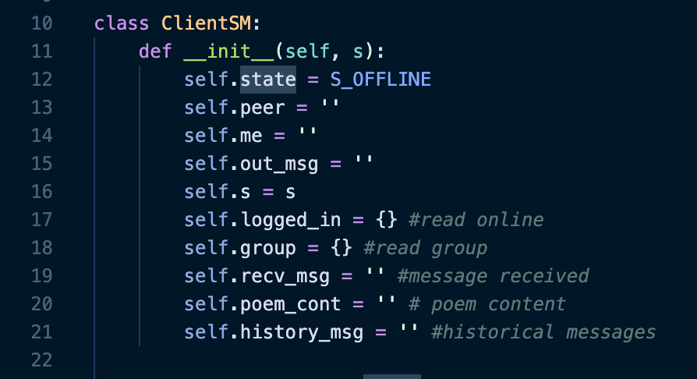
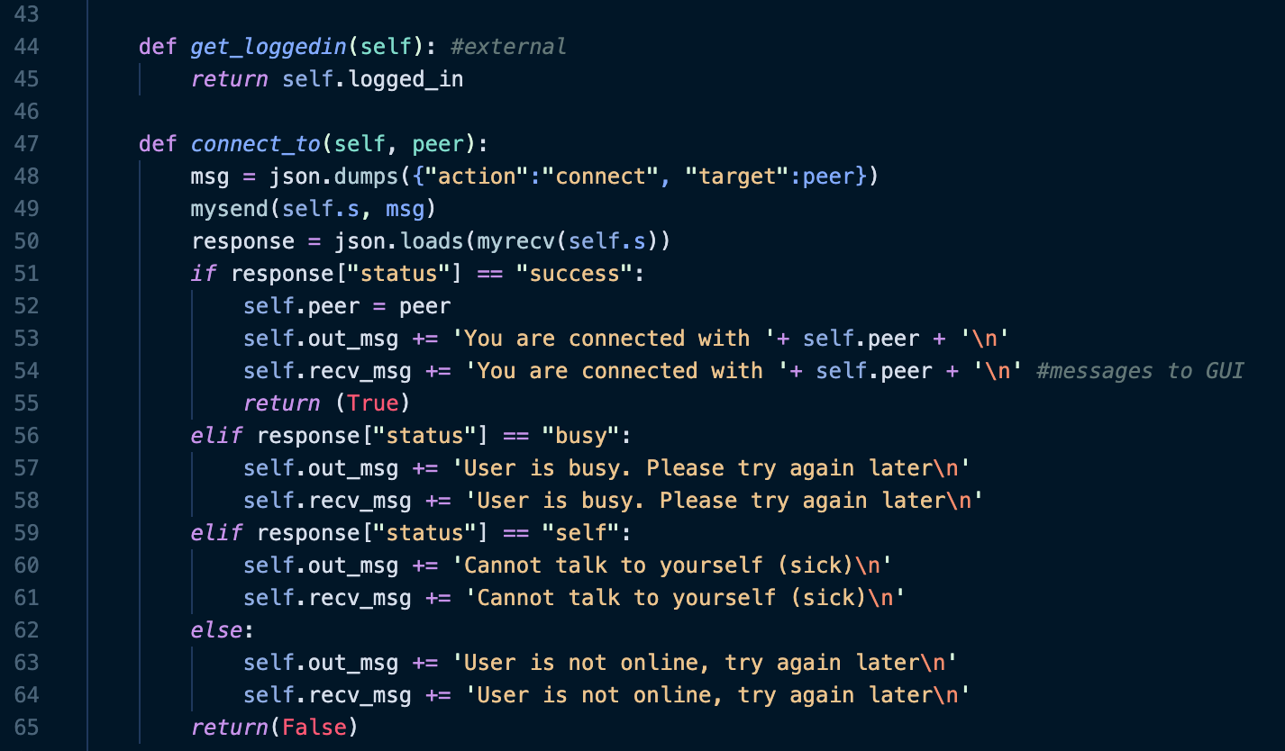
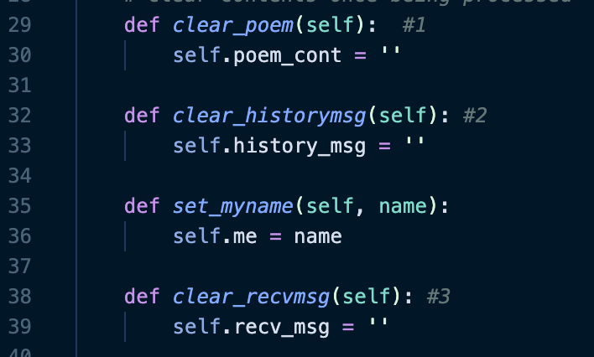
client_state_machine.py
Create New Attributes
Display Messages on GUI

Slide 12
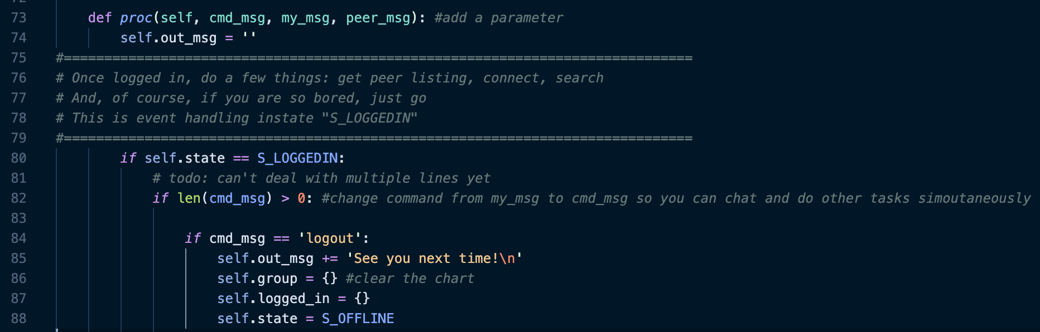
client_state_machine.py (Continued)

Slide 13
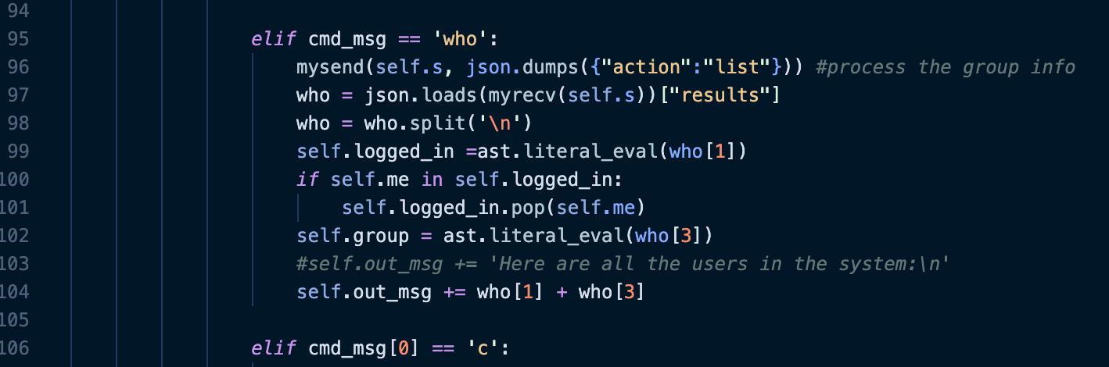
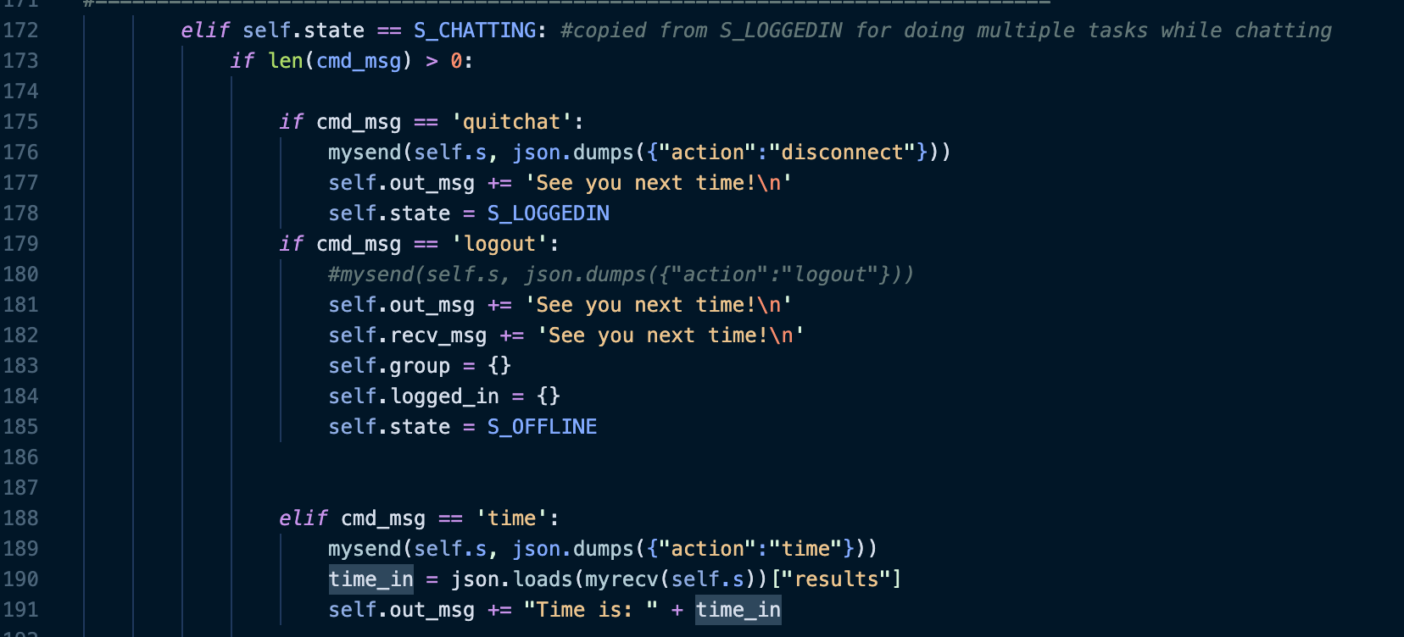
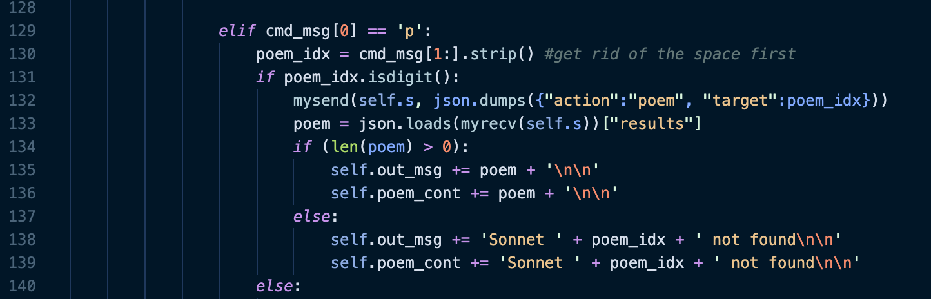
client_state_machine.py (Continued)
Copied from S_LOGGEDIN

Slide 14
Demonstration

Slide 15
Comments and Future Improvements
Structure:
Try to use OOP/separate the functions in different files
Let the chat_window to be the root level
Functionalities:
Change the font and its size
Set backgroud image
Create button to login again after logging out on the chat interface
Improve on the graphic design

Slide 16

Thanks for Watching

